Slide 1


The Party Switchers
Andrei Bartra, Angelo Cozzubo, Raymond Eid, Marc Richardson
CAPP 30122
March 2020

Slide 2
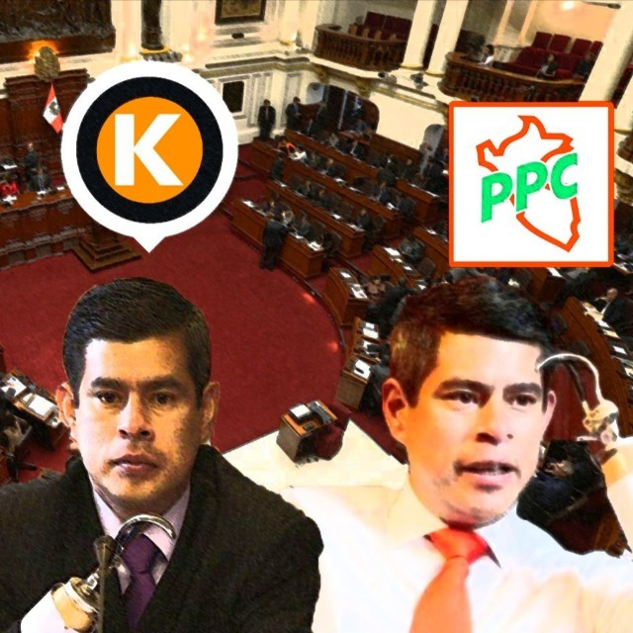
The context and the problem
L. Galarreta: Iconic Party Switcher in previous Congress elections
On September 30th 2019, Peruvian President Martin Vizcarra closed the Congress through a Constitutional measure.
By January 26th 2020, as required by the law, the President called for “Extraordinary Parliament Elections” (EPE-2020)
As highlighted by academics, Peru is a weak democratic state. It is commonly referred as “a democracy without political parties” (Tanaka, 2005)¹
The precarious political context in Peru has led to the atomization of political representation. Many parties are created for an election and dissolved after it.
This incentivized the appearance of PARTY SWITCHERS, which has not been systematically mapped to date.
2015-2019
2006-2015
1./ TANAKA, MARTÍN Democracia sin partidos. Perú 2000-2005: los problemas de representación y las propuestas de reforma política. Lima. IEP, 2005. ― (Colección Mínima. 57)

Slide 3
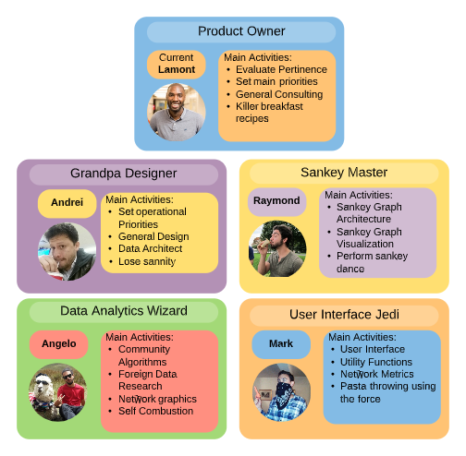
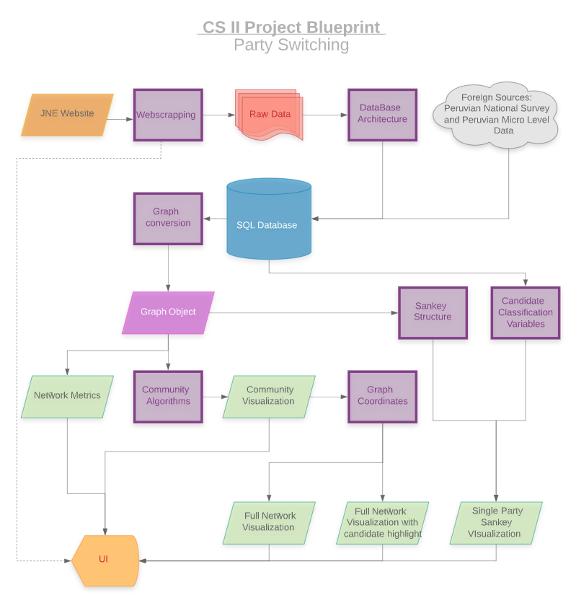
Our project PIPELINE
The team

Slide 4
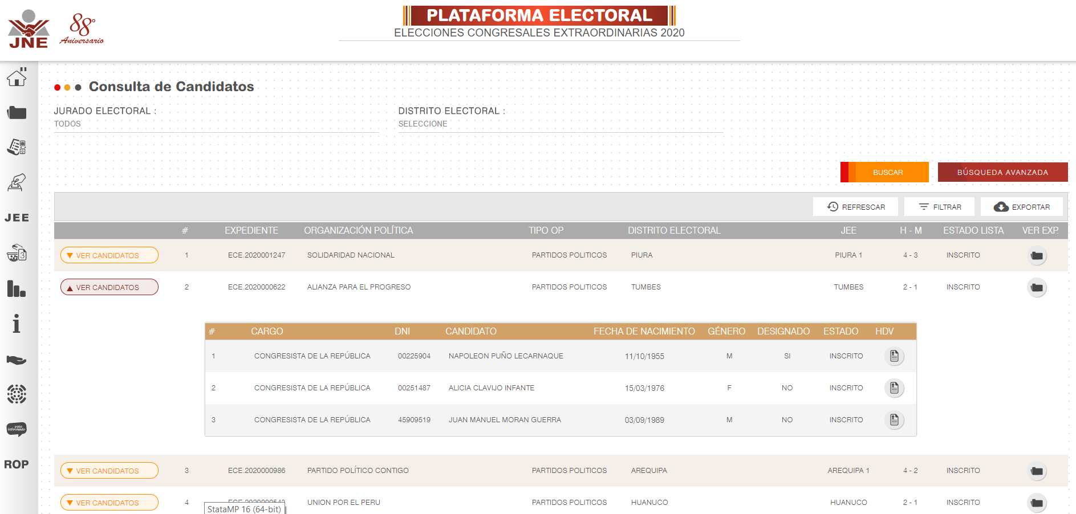
The National Jury of Elections webpage
Source: https://plataformaelectoral.jne.gob.pe/ListaDeCandidatos/Index

Slide 5
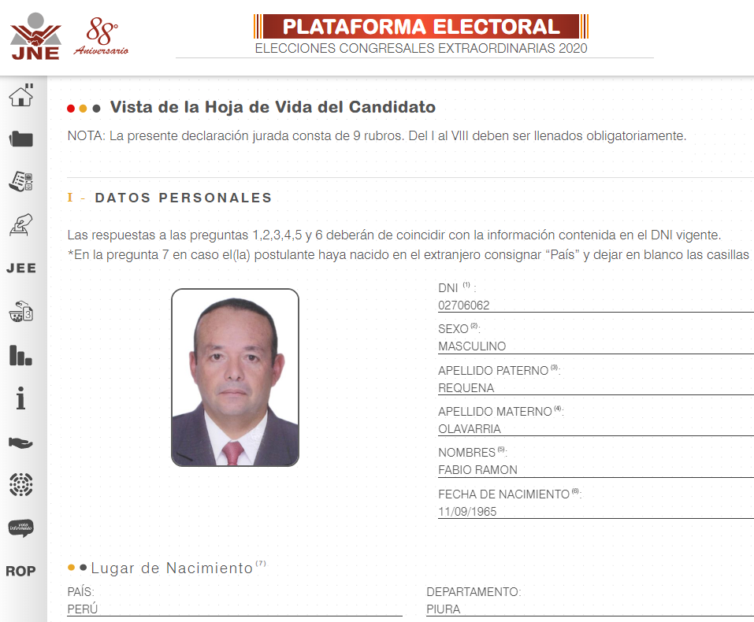

Candidate’s curriculum vitae - “Hoja de Vida”
Public information regarding:
Age, gender, date and place of birth
Education level and work experience
Criminal records, assets and income
Current and past Political Positions
Current and past Political Parties for which candidate was affiliated
This field let us identify the Party Switchers
Scraped CV info for all candidates in EPE-2020. Stored in SQL database.
Source: https://plataformaelectoral.jne.gob.pe/ListaDeCandidatos/Index

Slide 6

Secondary information: public DATASETS Merged with SQL
1
Living Standard Measurement Survey
ENAHO, 2018
Share of population in region that
knows what democracy is
trust in Congress
trust in Political Parties
democracy matters
democracy works
Merged at regional level considering region where candidate was born and currently lives
Share of population in district
Is female
Has no health insurance
Has a disability
Is indigenous
By education level (8 categories)
By religion (3 categories)
By age (4 categories)
Has electricity in household (hh)
Has water connection in hh
Has sewerage connection in hh
Lives in poverty
Peruvian National Institute of Statistics
2
Census and Administrative Data
District Information System, 2016
Merged at district level considering district where candidate was born and currently lives

Slide 7
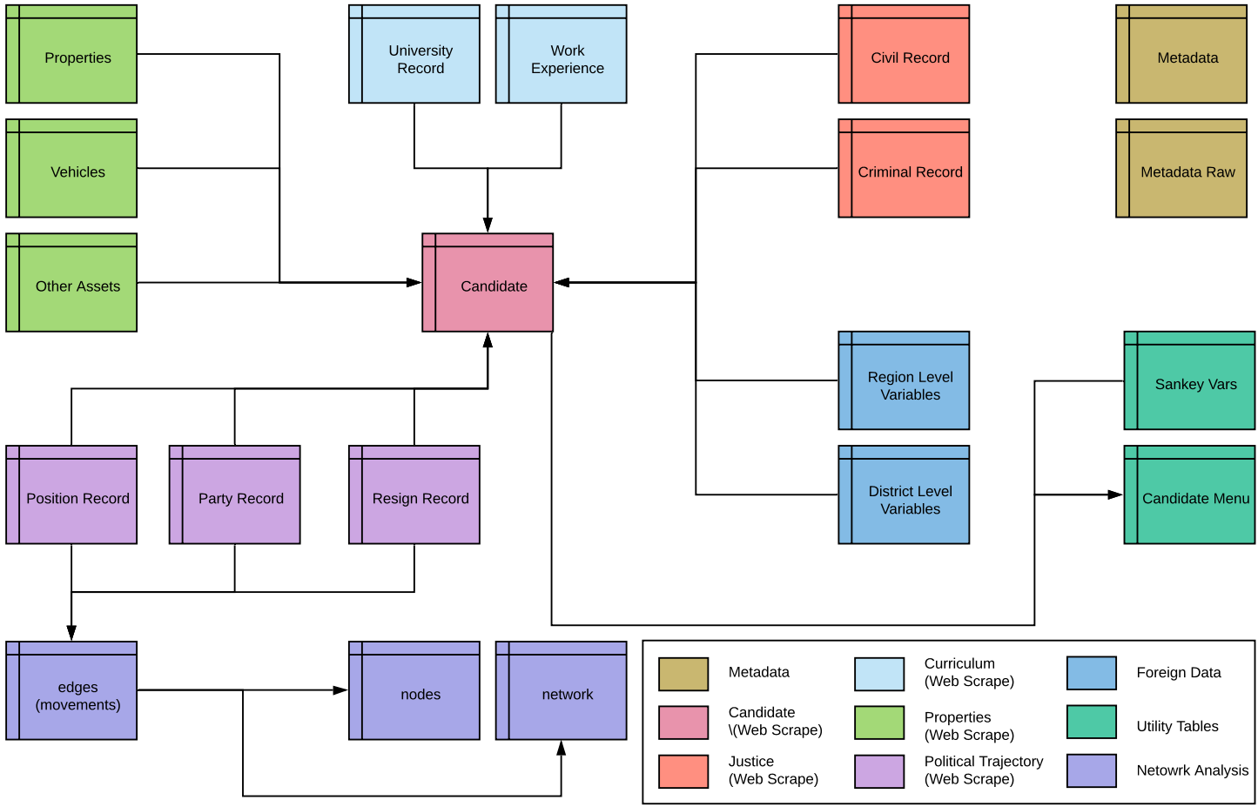
Database architecture

Slide 8
Network Community (CLUSTER) Analysis
To find the communities we first performed a Clauset, Newman and Moore Greedy Modularity Optimization.
We observed that the largest community was too large, so we applied Kernigham-Lin Bipartition on that one
Then we labeled every community according to the underlying political denominator of the community
Clauset, Newman and Moore Modularity Optimization
Optimizes the density of links within communities (modularity)
Uses a greedy approach
Kernighan–Lin bipartition algorithm
Finds a balanced partition such that the number of crosses between the partitions is at minimum
Uses a greedy approach

Slide 9
User interface: text-based interface
Web Scrape Demo
CSV files in output/demo_csv
Single Party Analysis
Select a Party
Select a Variable
Sankey Graph
Network Metrics
Select a Metric
Metrics text Display
MAIN MENU
Full Network Analysis
Cluster Graph
Community Level Network
Full Network
Full Network with communities
Candidate Level Analysis
Select a Region
Select a Party
Select a Candidate
Full graph with candidate highlight
Exit Program

Slide 10
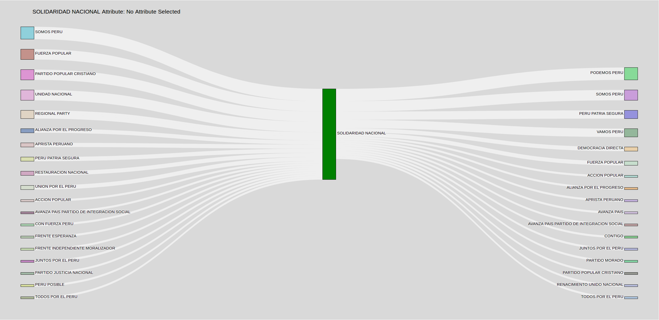
Outputs: Sankey diagrams
Party Switchers for “Solidaridad Nacional” Party. Total of Inflowing and Outflowing candidates.

Slide 11
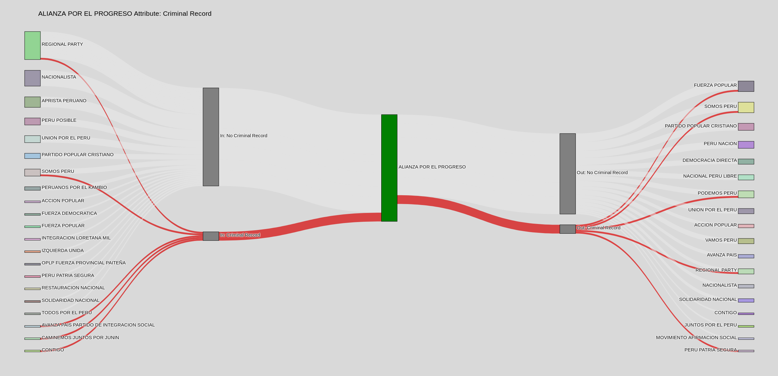
Outputs: Sankey diagrams by attributes
Party Switchers for “Alianza por el Progreso” Party. Highlighted in red candidates with criminal records
Inflows
Outflows
Into Category
Into Category

Slide 12
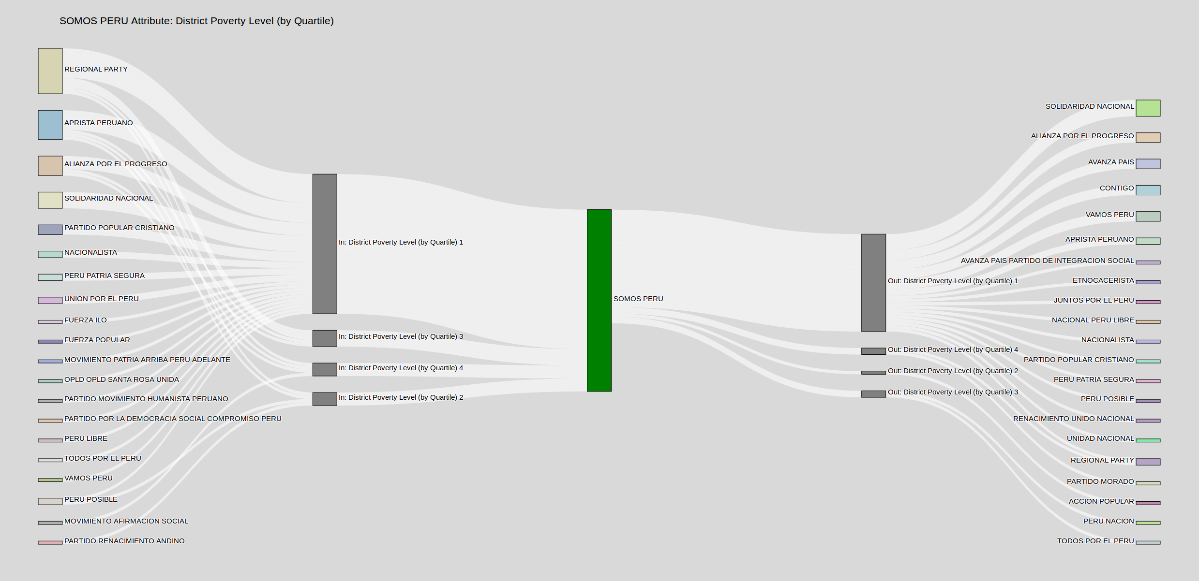
Outputs: Sankey diagrams by attributes of secondary data
Party Switchers for “Somos Peru” Party by poverty quartile (0-3) of the district where candidate lives
Outflows
Inflows
Into Category
Into Category

Slide 13
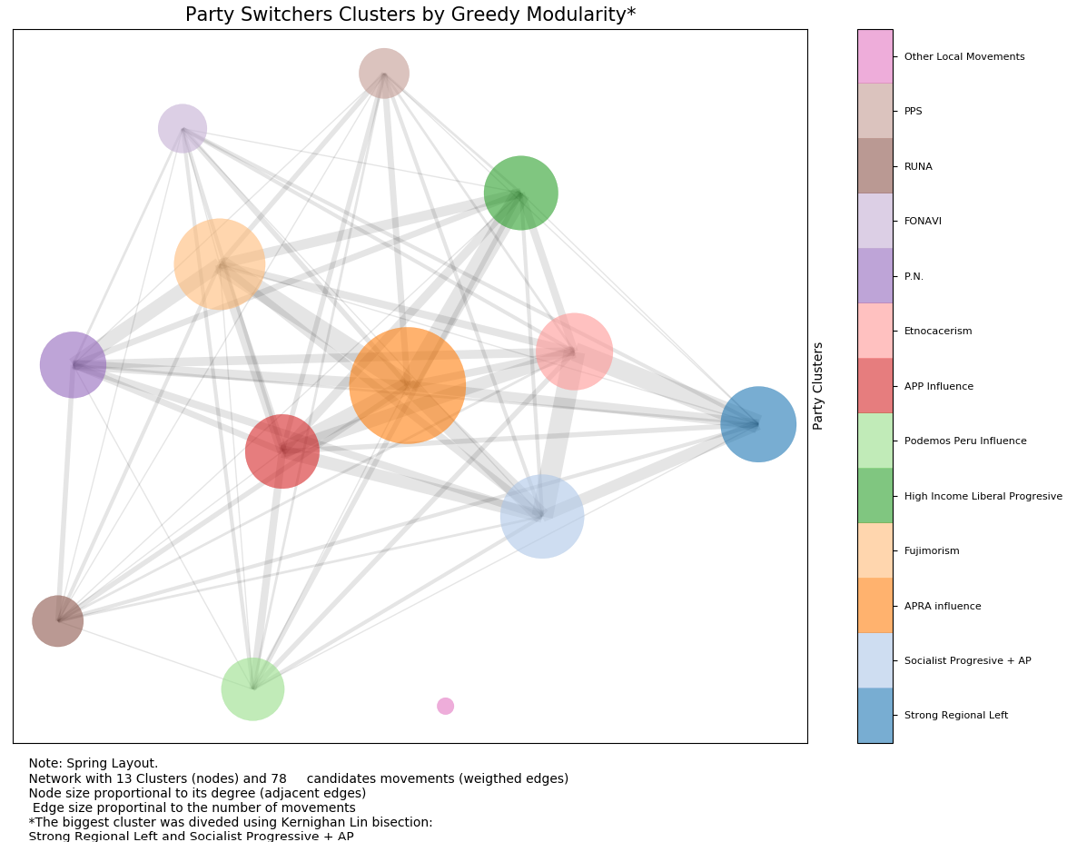
Community (Cluster) representation
Greedy Modularity grouped “Strong Regional Left” with Socialist Progressive + APP. With that result the underlying denominator was not clear
We applied Kernighan Lin Bipartition on that community and now it has better qualitative characteristics
The edge width is the number of edges between communities

Slide 14
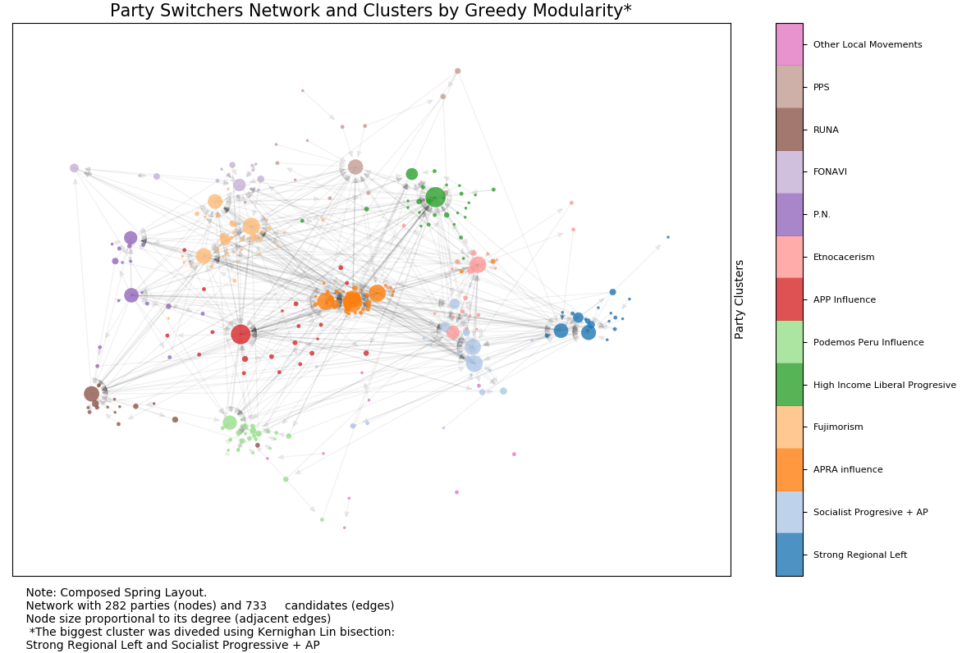
Full Network Representation
We took the resulting coordinates from the community graph as the initial frame
We generated a graph for each community using spring layout
The new coordinates were added to the community to generate a graph with clear separation between communities

Slide 15
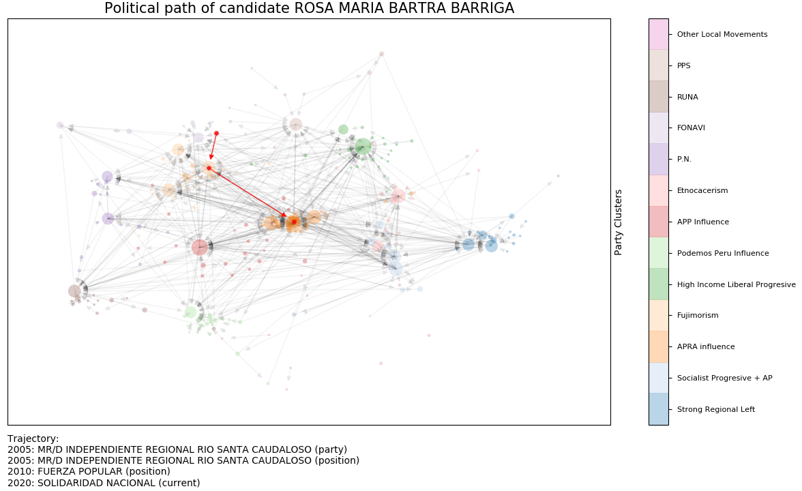
Candidate Level Highlight
Menu options: 4 - 15 - 18 - 1
Famous Peruvian Congresswoman that made a “convenient” switch to try to get reelected
“Fujimorism” got a big hit in its political capital, many former congresswoman and congressman moved to other parties to try to get reelected
NOT A RELATIVE TO A TEAM MEMBER!!!

Slide 16
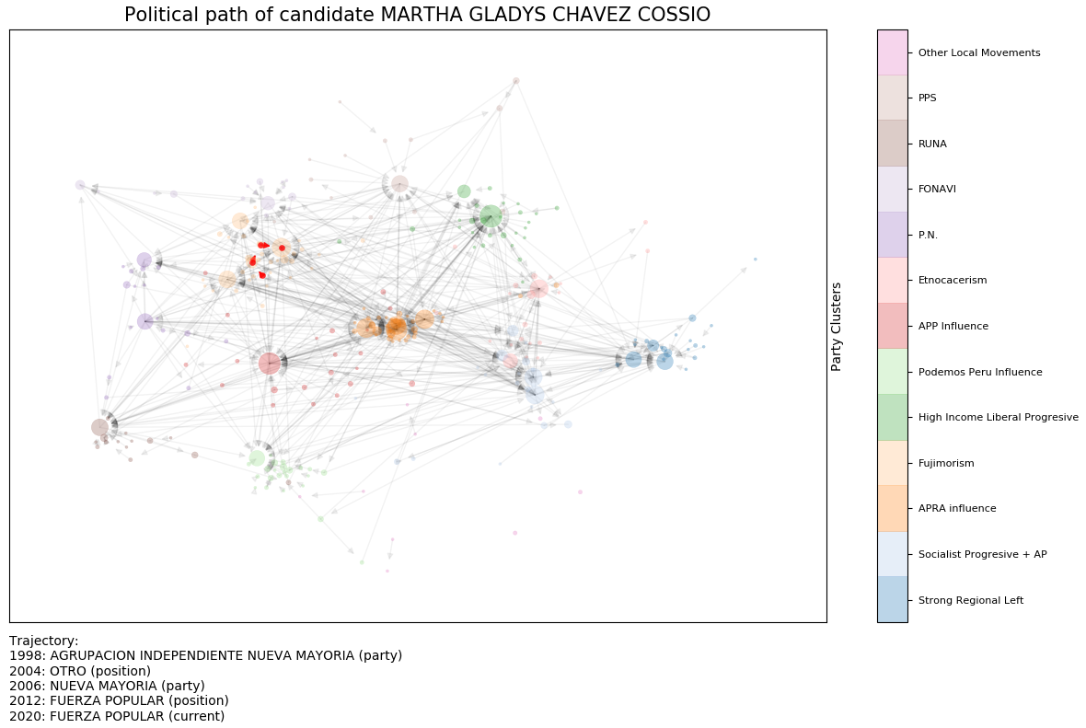
Candidate Level Highlight
A traditional candidate from the “Fujimorism”. The party has changed names over time, but always with the same people

Slide 17
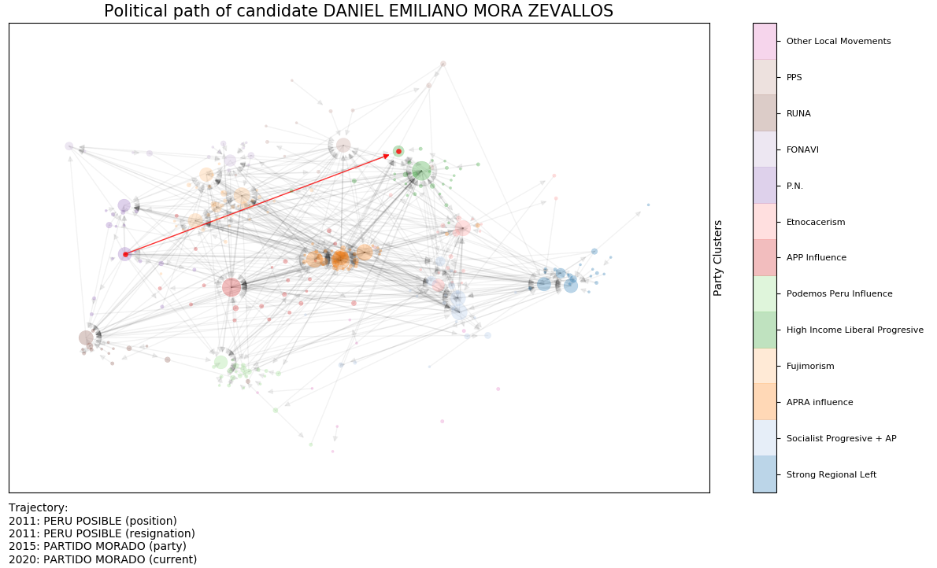
Candidate Level Highlight
“Peru Posible” was a protagonist party in the early 2000’s
In the end (like most of the parties) got involved in corruption scandals
This particular candidate distanced from the scandals and moved to a new party

Slide 18



Thanks for the course and for introduce us to the warm syrup!

Slide 19
The Party Switchers

